Slide 2
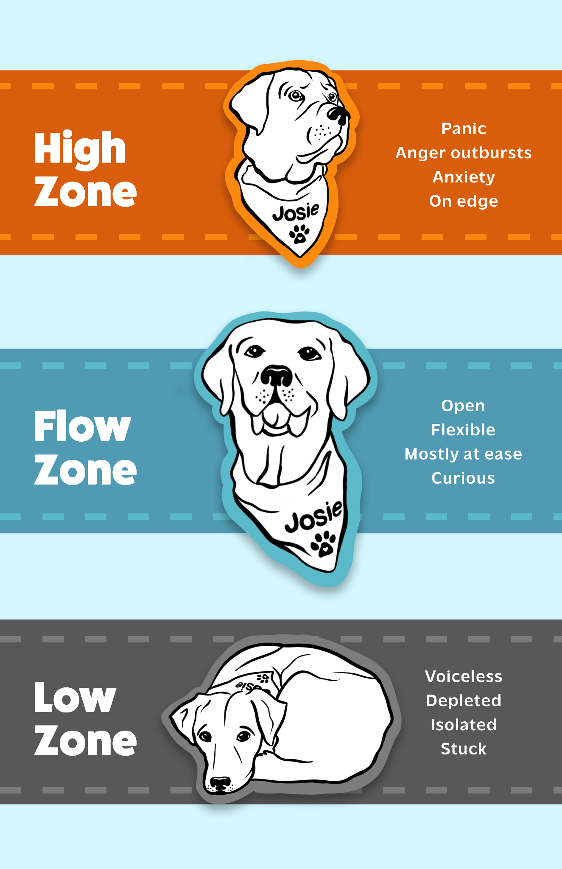
Wellness Wakeup
Journaling:
Draw a graph of what you want in your day. Add your own X and Y axis.
Notes:
Some examples of x and y axes may be: work, play, sleep, org duties, social time, screen time

Slide 3
Wellness Wakeup
Think of a metaphor from the natural environment to tell your neighbor what your day has been like. What zone are you in?
Notes:
Has your day been like a calm lake, or windy day, or tornado? What zone are you in due to the nature of your day?

Slide 4
Wellness Wakeup
If today was an ice cream flavor, what would it be and why? What zone are you in as you reflect on that?
Notes:
Is your day like smooth chocolate, or surprising Moose Tracks, or an undesirable a flavor? What zone are you in due to the nature of your day?

Slide 5
Wellness Wakeup
Where is a spot you tend to feel ease while on campus? Where do you notice ease in your body?
Notes:
This skill is Resourcing and Tracking. Resourcing is thinking of person, place, object or value that gives you a sense of ease or strength, and we can Track to notice ease in our body if ease occurs.

Slide 6
Wellness Wakeup
Play quick charades with your neighbor for your favorite activity that puts you in your Flow Zone.
Notes:
Make a gesture or movement to get your neighbor to guess your favorite activity. Can you guess theirs? Do you have anything in common or not with your favorite activity?

Slide 7
Wellness Wakeup
When you go to get your hair done, what sensations are most pleasant to you? Share with a neighbor.
Notes:
Getting your hair done is a very sensory experience. Do you like the smells, touch, temperature, sounds of this activity? Does it give you a felt sense of ease or does it tend to bump you from your zone? Either is okay, just notice what happens.

Slide 8
Wellness Wakeup
When you’re in the high zone do you tend to walk faster or slower? What body part tells you you’re in the high zone?
Notes:
We get bumped into the high zone when our brain sends the signal to take action. Sometimes this signal is very helpful and sometimes not so much. We can notice our brain is trying to help us when we go high.

Slide 9
Wellness Wakeup
What non-verbal communication from others tells you that it’s a judgment free zone?
Notes:
Non-verbal communication tells us a lot about the state of our nervous system. Who is someone who doesn’t judge you and what do their faces, shoulders, and body language tend to communicate that it’s a safe place?

Slide 10
Wellness Wakeup
What is your favorite online resource to help your nervous system chill out? Funny memes? A social media platform? Group chats?
Notes:
Our digital life can alter our zones. What do you notice tends to help you re-enter the flow zone?

Slide 11
Wellness Wakeup
Sometimes we can find body parts that are generally feeling neutral. Have you noticed any that are often kinda fine?
Notes:
People find different sensations at different times, but some people have learned to find parts that are like anchors for their nervous system. Usually our ear lobes, or the tip of our nose is often pretty neutral because there aren’t many nerve endings there.

Slide 12
Wellness Wakeup
If today were a garden, what would you like to plant in it? What color and size would the plant be?
Notes:
Sometimes it feels good to give our fight/flight/freeze/friend system a little break but visualizing something creatively. This engages different regions of the brain than our survival network.

Slide 13
Wellness Wakeup
Tell the person next to you what Zone you’re in right now and how you know.
Notes:
Here is an icebreaker invitation for us. Check out the Zones here and share a thought with the person next to you about which Zone you may be in right now. No right or wrong answer, and it’s definitely okay and normal to be out of our Flow Zone. When we are out of our Flow Zone it means our body is trying to help us navigate something.

Slide 14
Wellness Wakeup
Tell the person next to you which therapy dog is your favorite and why.
Do you notice any neutral or pleasant sensations inside?
Notes:
If students need help identifying pleasant or neutral sensations, you can ask, “Does anything light up or feel nice when you think about the therapy dogs? Like your chest or face?”
It’s okay if students don’t have this response to the therapy dogs. You can suggest they think about another animal.

Slide 15
Wellness Wakeup
Tell the person beside you what has been difficult for you this week, and also what is helping you get through.
Notes:
If the students know one another reasonably well, you can encourage students to move beyond the topic of academics, and into something difficult with a friend or family member if they would like to do so.
“We are getting by in some way because something is important to us or driving us along- this is a resource we can remember and feel grateful for.”

Slide 16
Wellness Wakeup
Notice any sensations in your pinky toes and fingers
Do they feel neutral, pleasant or unpleasant?
Notes:
This prompt would be a great way to start a meeting or class. It is brief. Remind the group that we can check our bodies for neutral or pleasant sensations to help counterbalance our survival responses, the fight/flight/freeze/friend responses generated by the autonomic nervous system.

Slide 17
Wellness Wakeup
Tell the person behind or in front of you whether you prefer hot or cold beverages when you’re bumped out of your Zone.
Notes:
Share your own (nonalcoholic) beverage item and describe any pleasant or neutral shifts that occur when you picture it or drink it.

Slide 18
Wellness Wakeup
See if you can find each color of the rainbow around you.
Do you notice any neutral or pleasant sensations inside?
Notes:
Share that it is good for our nervous system to notice our surroundings to help ground us in right now. It can give us a break from concerns about the past or future, over which we have less control.

Slide 19
Wellness Wakeup
Remember a funny video you recently saw. Does anything shift to neutral or pleasant inside your body?
Notes:
Describe or share a funny video or image for yourself, and describe if anything inside you ‘opens up’ or ‘lightens up’ such as places in your torso, shoulders, face, etc.

Slide 20
Wellness Wakeup
Describe your favorite animal. Can you imagine some of your senses if it were nearby?
Notes:
Share that you can picture this animal and which of your five senses goes online when you imagine it. For example, your sense of touch is evoked in your imagination when you picture petting this animal or it sitting near you. Perhaps you can notice it’s smell or can hear the sound it makes. Remind the group that using our senses can be a powerful way to regulate our nervous system.

Slide 21
Wellness Wakeup
Tell the person beside you the last thing you tried to come back to your Zone when you were recently bumped out.
Notes:
Normalize for the group that we will get bumped out of our zone due to the elegant and sensitive nature of our survival responses in our nervous system.

Slide 22
Wellness Wakeup
Notice the temperature of the air around you right now.
Notice the sensation of your feet on the ground.
Notes:
Share with the group that this is a way that we can allow our nervous system to notice if we are ‘kinda fine’ right now, which sometimes can help us re-connect to our Flow Zone.

Slide 23
Wellness Wakeup
Tell the person next to you a time when you knew you were in your Flow Zone.
Notes:
If you like, you can ask the group if anyone felt pleasant or neutral sensations when they shared or listened to the other person. Sometimes our nervous system will co-regulate with someone else.

Slide 24
Wellness Wakeup
Find a photo in your phone camera roll that gives you a sense of strength, joy or calm.
Share the photo with your neighbor.
Notes:
If you like, you can ask the group if anyone felt pleasant or neutral sensations when they shared or listened to the other person. Sometimes our nervous system will co-regulate with someone else.

Slide 25
Wellness Wakeup
Take a moment to jot down one specific thing you are grateful for today. It can be small, but please be specific.
Notes:
Today we are going to do a gratitude practice to ground ourselves as we transition to ___________(class, meeting, etc.). Gratitude practices can help us practice non judgemental awareness, find positive takeaways in neutral or negative situations, prevent ruminating on difficult times, and prevent us from getting overwhelmed by the future.
Gratitude’s biggest impact is when it is intentional and specific so while it is great to say “I am grateful for my friends” it makes an even bigger impact to go deeper such as “I am grateful for the time I was able to spend with my friends Emily and Jackson at lunch earlier today.”
Take a moment to jot down one specific thing you are grateful for today. It doesn’t have to be profound, but do make it specific! (Give folks a minute or two to reflect on what they are grateful for).
Discussion questions you could ask:
Does anyone want to share what they are feeling grateful for?
How does it feel to reflect on what you’re grateful for?
How might you practice gratitude daily?
I appreciate you all engaging in that activity and hope you can find time each day to reflect on what you are grateful for. As we turn our attention to ________ remind yourself of your gratitude if you feel yourself getting overwhelmed.

Slide 26
Wellness Wakeup
Divide on a piece of paper into two halves.
On one side what is ‘Controllables’ and on the other add ‘Uncontrollables’
Notes:
As we transition into ___________(class, meeting, etc.) today, I recognize that you might have a lot on your plate. Let’s take a moment to reflect on all the things that are going through your mind and take them from your mind to paper.
Divide a piece of paper into two halves and on one side write “controllables” and on the other side write “uncontrollables”. Now put all the thoughts and worries you have into the appropriate category on your paper based on what is in your control and what is not.
Give folks a few minutes to dump their thoughts on their papers.
Potential discussion questions (in small groups or as a large group):
Is it helpful to see your thoughts laid out on paper as opposed to floating around in your head?
How will you prioritize the things that are in your control?
How will you let go of the things that are not in your control?
Now that your thoughts are on paper we can turn our attention to ____________. Later you can return to your paper to work through the things in your control.

Slide 27
Wellness Wakeup
Share with a neighbor:
Rose- One thing going well
Bud- Looking forward to
Thorn- Not going well
Notes:
As we transition into ___________(class, meeting, etc.) today, I want to make sure we have time to acknowledge how our weeks are going.
To do this today, we will engage in the Rose, Bud, Thorne, activity. In this activity pair up and share with you partner one thing that is going well this week (rose), one thing that you are looking forward to (bud), and one thing that is not going well this week (thorne).
Give a few minutes for pairs to share.
Potential discussion questions:
Any themes coming up in terms of things not going well that we should be aware of?
What are things that are going well for folks?
What are people looking forward to?
It’s important to acknowledge both the things that are not going well and the things that are going well in our lives. When you find yourself becoming overwhelmed this week and even potentially in this ________ as we transition, remind yourself of the things you are looking forward to.

Slide 28
Wellness Wakeup
Journaling moment:
Write down things, or activities, that make you the happiest. Why do they make you happy?
Notes:
As we transition into ___________(class, meeting, etc.) today, let’s take a few moments to ground ourselves through journaling. Journaling can be done in many different ways and does not have to be long and drawn out, it can also be super short.
Choose one of these prompts and reflect and write in whatever way feels best for you about it:
Write down things, or activities, that make you the happiest. Why do they make you happy?
What makes you feel like your most authentic self? Is it being around a certain person, doing a certain activity, etc..
Write one to three things that inspire you to be your best self?
What helps brighten your day when you are going through a hard time?
What makes you feel the most confident?
What are your strengths?
Give folks a few minutes to jot down their thoughts
Potential discussion questions:
How does it feel to reflect on these things or parts of yourself?
Is it difficult to think about positives?
Are there other ways that you like to journal to help center yourself?
When you are feeling low, return to these positive thoughts about yourself or things you like to do to help yourself feel better. As we transition to ____________ if you feel challenged, remind yourself of your strengths.

Slide 29
Wellness Wakeup
Journaling moment:
What makes you feel like your most authentic self? Is it being around a certain person, doing a certain activity, etc?
Notes:
As we transition into ___________(class, meeting, etc.) today, let’s take a few moments to ground ourselves through journaling. Journaling can be done in many different ways and does not have to be long and drawn out, it can also be super short.
Choose one of these prompts and reflect and write in whatever way feels best for you about it:
Write down things, or activities, that make you the happiest. Why do they make you happy?
What makes you feel like your most authentic self? Is it being around a certain person, doing a certain activity, etc..
Write one to three things that inspire you to be your best self?
What helps brighten your day when you are going through a hard time?
What makes you feel the most confident?
What are your strengths?
Give folks a few minutes to jot down their thoughts
Potential discussion questions:
How does it feel to reflect on these things or parts of yourself?
Is it difficult to think about positives?
Are there other ways that you like to journal to help center yourself?
When you are feeling low, return to these positive thoughts about yourself or things you like to do to help yourself feel better. As we transition to ____________ if you feel challenged, remind yourself of your strengths.

Slide 30
Wellness Wakeup
Journaling moment:
Write one to three things that inspire you to be your best self.
Notes:
As we transition into ___________(class, meeting, etc.) today, let’s take a few moments to ground ourselves through journaling. Journaling can be done in many different ways and does not have to be long and drawn out, it can also be super short.
Choose one of these prompts and reflect and write in whatever way feels best for you about it:
Write down things, or activities, that make you the happiest. Why do they make you happy?
What makes you feel like your most authentic self? Is it being around a certain person, doing a certain activity, etc..
Write one to three things that inspire you to be your best self?
What helps brighten your day when you are going through a hard time?
What makes you feel the most confident?
What are your strengths?
Give folks a few minutes to jot down their thoughts
Potential discussion questions:
How does it feel to reflect on these things or parts of yourself?
Is it difficult to think about positives?
Are there other ways that you like to journal to help center yourself?
When you are feeling low, return to these positive thoughts about yourself or things you like to do to help yourself feel better. As we transition to ____________ if you feel challenged, remind yourself of your strengths.

Slide 31
Wellness Wakeup
Journaling moment:
What helps brighten your day when you are going through a hard time?
Notes:
As we transition into ___________(class, meeting, etc.) today, let’s take a few moments to ground ourselves through journaling. Journaling can be done in many different ways and does not have to be long and drawn out, it can also be super short.
Choose one of these prompts and reflect and write in whatever way feels best for you about it:
Write down things, or activities, that make you the happiest. Why do they make you happy?
What makes you feel like your most authentic self? Is it being around a certain person, doing a certain activity, etc..
Write one to three things that inspire you to be your best self?
What helps brighten your day when you are going through a hard time?
What makes you feel the most confident?
What are your strengths?
Give folks a few minutes to jot down their thoughts
Potential discussion questions:
How does it feel to reflect on these things or parts of yourself?
Is it difficult to think about positives?
Are there other ways that you like to journal to help center yourself?
When you are feeling low, return to these positive thoughts about yourself or things you like to do to help yourself feel better. As we transition to ____________ if you feel challenged, remind yourself of your strengths.

Slide 32
Wellness Wakeup
Journaling moment:
What makes you feel confident?
Notes:
As we transition into ___________(class, meeting, etc.) today, let’s take a few moments to ground ourselves through journaling. Journaling can be done in many different ways and does not have to be long and drawn out, it can also be super short.
Choose one of these prompts and reflect and write in whatever way feels best for you about it:
Write down things, or activities, that make you the happiest. Why do they make you happy?
What makes you feel like your most authentic self? Is it being around a certain person, doing a certain activity, etc..
Write one to three things that inspire you to be your best self?
What helps brighten your day when you are going through a hard time?
What makes you feel the most confident?
What are your strengths?
Give folks a few minutes to jot down their thoughts
Potential discussion questions:
How does it feel to reflect on these things or parts of yourself?
Is it difficult to think about positives?
Are there other ways that you like to journal to help center yourself?
When you are feeling low, return to these positive thoughts about yourself or things you like to do to help yourself feel better. As we transition to ____________ if you feel challenged, remind yourself of your strengths.

Slide 33
Wellness Wakeup
Journaling moment:
Which of your strengths is getting you through today?
Notes:
As we transition into ___________(class, meeting, etc.) today, let’s take a few moments to ground ourselves through journaling. Journaling can be done in many different ways and does not have to be long and drawn out, it can also be super short.
Choose one of these prompts and reflect and write in whatever way feels best for you about it:
Write down things, or activities, that make you the happiest. Why do they make you happy?
What makes you feel like your most authentic self? Is it being around a certain person, doing a certain activity, etc..
Write one to three things that inspire you to be your best self?
What helps brighten your day when you are going through a hard time?
What makes you feel the most confident?
What are your strengths?
Give folks a few minutes to jot down their thoughts
Potential discussion questions:
How does it feel to reflect on these things or parts of yourself?
Is it difficult to think about positives?
Are there other ways that you like to journal to help center yourself?
When you are feeling low, return to these positive thoughts about yourself or things you like to do to help yourself feel better. As we transition to ____________ if you feel challenged, remind yourself of your strengths.

Slide 34
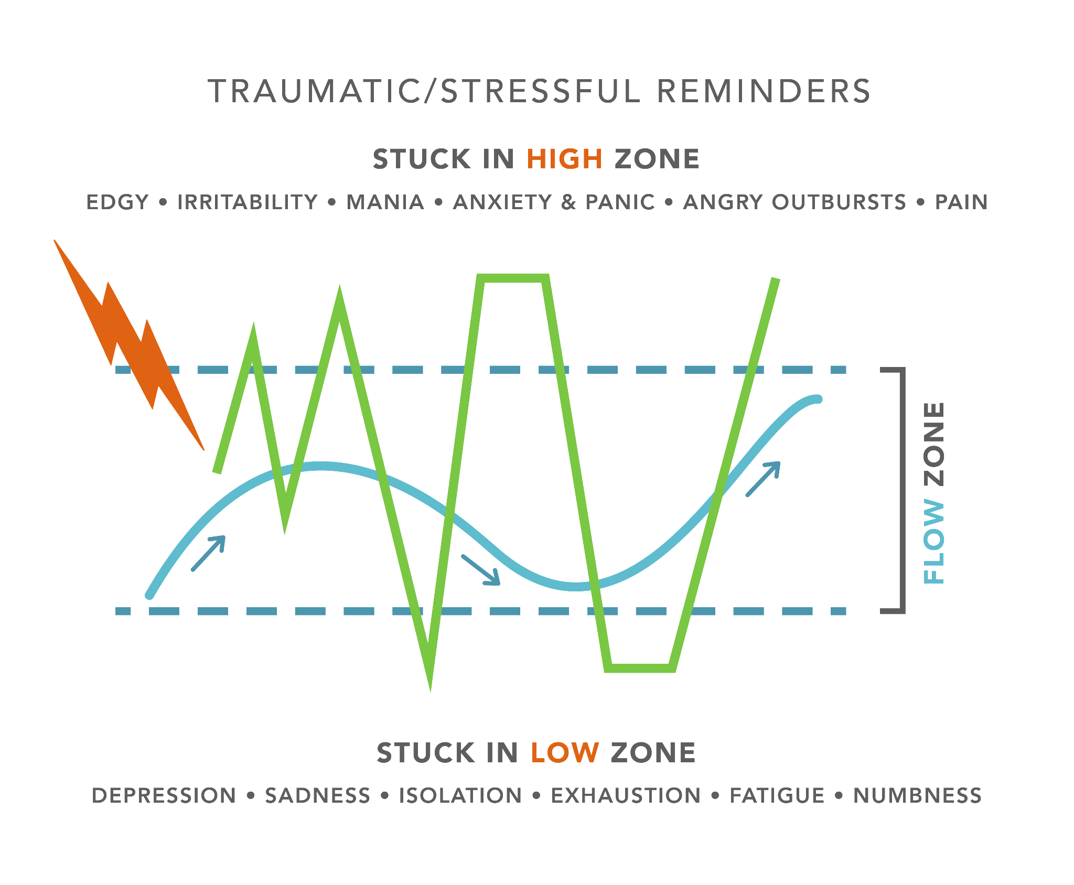
Notes:
These are the main ideas we will be talking about- a simplistic way of understanding our fight/flight/freeze/fawn responses
I am hearing Cadets don’t love the flow zone ☺

